Slide 1
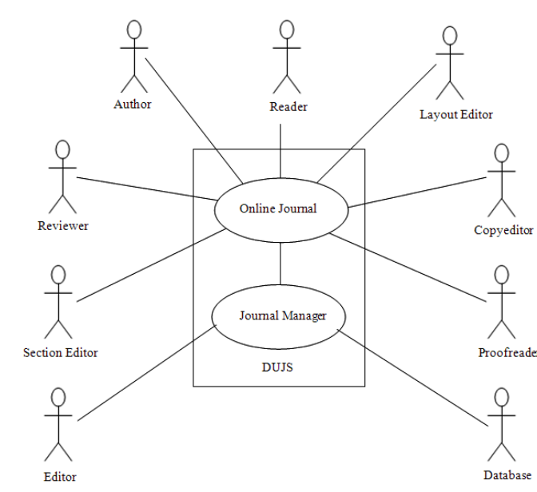
System Environment

Slide 2
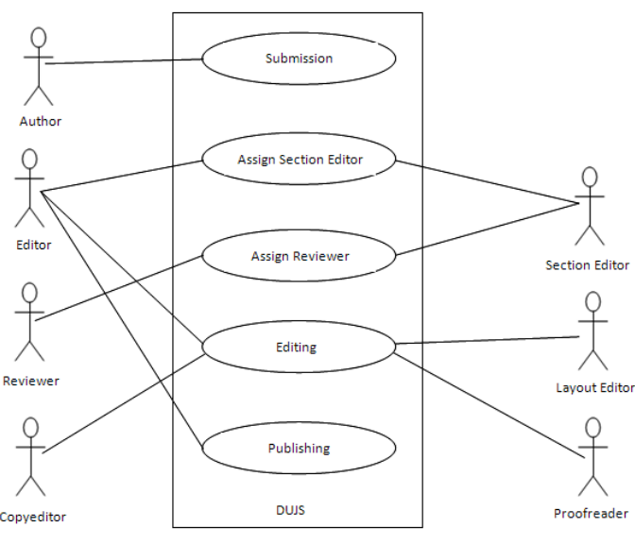
Journal Activities

Slide 3
Structural Functionalities
Author Submission
Assigning Section Editor
Reviewing Process
Editing Phase
Publishing Manuscript to the Issue

Slide 4
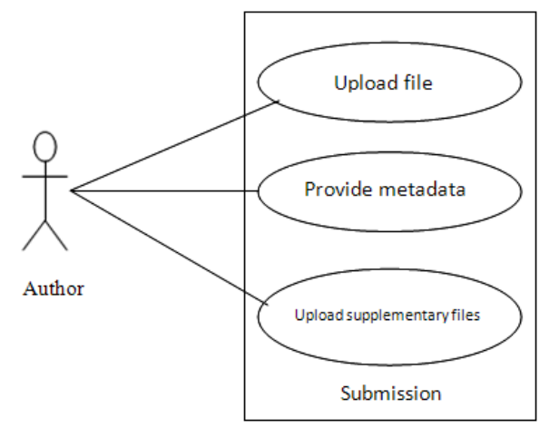
Submitting Article

Slide 5
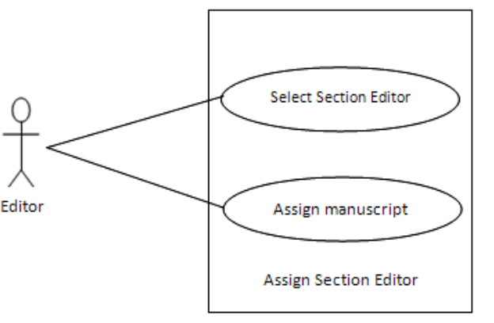
Assigning Section Editor

Slide 6
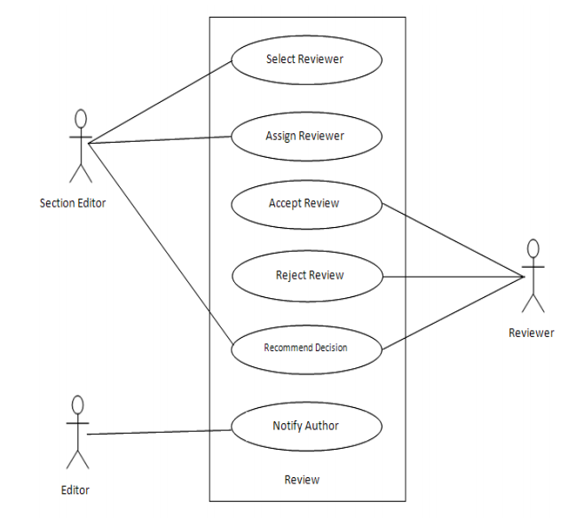
Review of the Manuscript

Slide 7
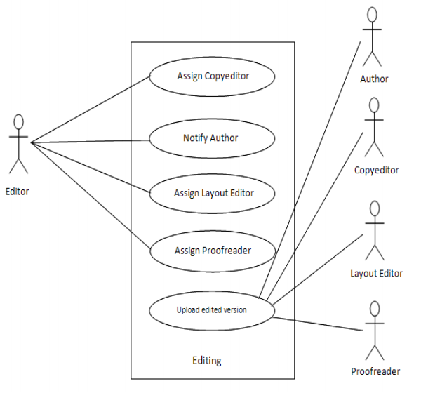
Editing Process of the Manuscript

Slide 8
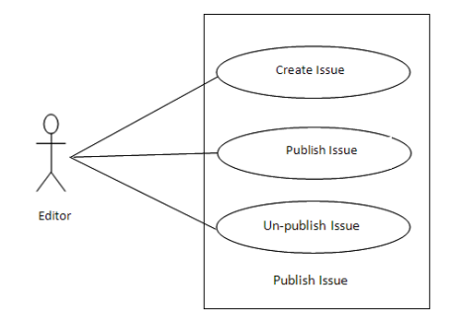
Publishing Manuscript to the Issue

Slide 9
